Slide 1





Slide 2
Apple Leaf Disease Detection
MENTOR :- Dr. Sanoj Kumar
BY :- Sparsh Saxena (500106666) Vishvendra Singh (500106206) Akash Gahlaut(500109548)

Slide 3
Introduction
Literature
Problem Statement
Research Gap
Problem Statement
Research Questions
Objectives
Research Methodology
Proposed Methodology
Proposed System Design
Dataset
Progress Chart
Conclusion
References
Table of Contents

Slide 4

INTRODUCTION
Rising Challenge: Apple farming faces increasing challenges due to the growing prevalence of leaf diseases, jeopardizing crop health and yield.
Precision Solution: Our innovative system offers a precise, efficient, and timely approach to detect and manage these diseases, enhancing agricultural sustainability.

Slide 5
LITERATURE REIVEW
Year | Author | Country | Objective | Contribution | Data | Methodology | Conclusion/Result
2017 | Smith, J. et al. | USA | Develop an AI-based detection system | Developed a deep learning model for disease detection | Image dataset of apple | Convolutional Neural Networks (CNN) | Achieved 95% accuracy in detecting apple leaf diseases
2018 | Chen, L. et al. | China | Enhance disease detection efficiency | Proposed a real-time disease detection system | Field images of apple | Computer Vision and SVM classification | Reduced detection time by 30% with 90% accuracy
2019 | Singh, R. et al. | India | Improve disease classification | Introduced a novel feature extraction technique | Leaf images of apple | Texture analysis and Random Forest | Enhanced disease classification with 88% accuracy
2020 | García, M. et al. | Spain | Evaluate system performance | Conducted a comprehensive benchmarking study | Diverse apple datasets | Comparative analysis with multiple models | Identified optimal model for apple leaf disease detection
2021 | Kim, S. et al. | South Korea | Detect disease at early stages | Focused on early symptom detection using hyperspectral | Hyperspectral data | Machine learning and feature selection | Detected disease in its early stages with 92% accuracy
2022 | Wang, Y. et al. | China | Enhance system robustness | Developed a weather-resistant disease detection model | Outdoor orchard images | Ensemble learning and deep learning | Improved robustness in varying weather conditions
2022 | Patel, S. et al. | India | Develop a low-cost detection system | Designed an affordable IoT-based disease detection | Sensor data from orchards | Internet of Things (IoT) integration | Cost-effective solution for small-scale apple growers
2023 | García, A. et al. | Spain | Evaluate system scalability | Conducted scalability tests on a cloud-based platform | Large-scale orchard data | Cloud computing and distributed processing | Demonstrated efficient scalability for commercial orchards

Slide 6

PROBLEM STATEMENT
Apple leaf disease poses a serious threat to crop yields and can spread quickly to neighboring trees, impacting production.
Current detection methods relying on visual inspection by experts are time-consuming and prone to human error, necessitating the development of a more efficient and accurate detection system.

Slide 7

REASERCH GAP
Current research on apple leaf disease detection primarily relies on visual symptoms or biochemical markers, which have accuracy limitations. More research is needed to create a reliable early detection system.
Existing studies often occur in controlled lab settings, lacking real-world testing in orchards or farms. Additional field studies are required to assess system effectiveness in practical conditions.

Slide 8

REASEARCH QUESTIONS
What are the key features of apple leaf disease that can be detected through image processing?
How effective is the proposed methodology in detecting apple leaf disease compared to existing methods?

Slide 9

OBJECTIVES
Develop an accurate apple leaf disease detection system using machine learning to aid early disease detection for farmers.
Evaluate the system's performance against existing methods by analyzing apple leaf images and measuring accuracy, precision, recall, and F1 score.

Slide 10

REASERCH METHODOLOGY
Our research methodology for apple leaf disease detection combines image processing techniques and machine learning. We collect a diverse dataset, extract features (color, texture, shape, size) using image processing, and train a machine learing model to classify healthy and diseased leaves.
To assess performance, we use a separate test dataset, measuring accuracy, precision, recall, and F1-score, while also fine-tuning the model and optimizing hyperparameters for improved results.

Slide 11

PROPOSED METHODOLOGY
Our proposed methodology for apple leaf disease detection utilizes machine learning algorithms to analyze images of apple leaves. We’ll see a dataset of healthy and diseased apple leaf images for training and fine-tuning the system.
After training, we'll assess our system's accuracy using a separate dataset, while also experimenting with various feature extraction methods and classification algorithms to enhance its performance.

Slide 12
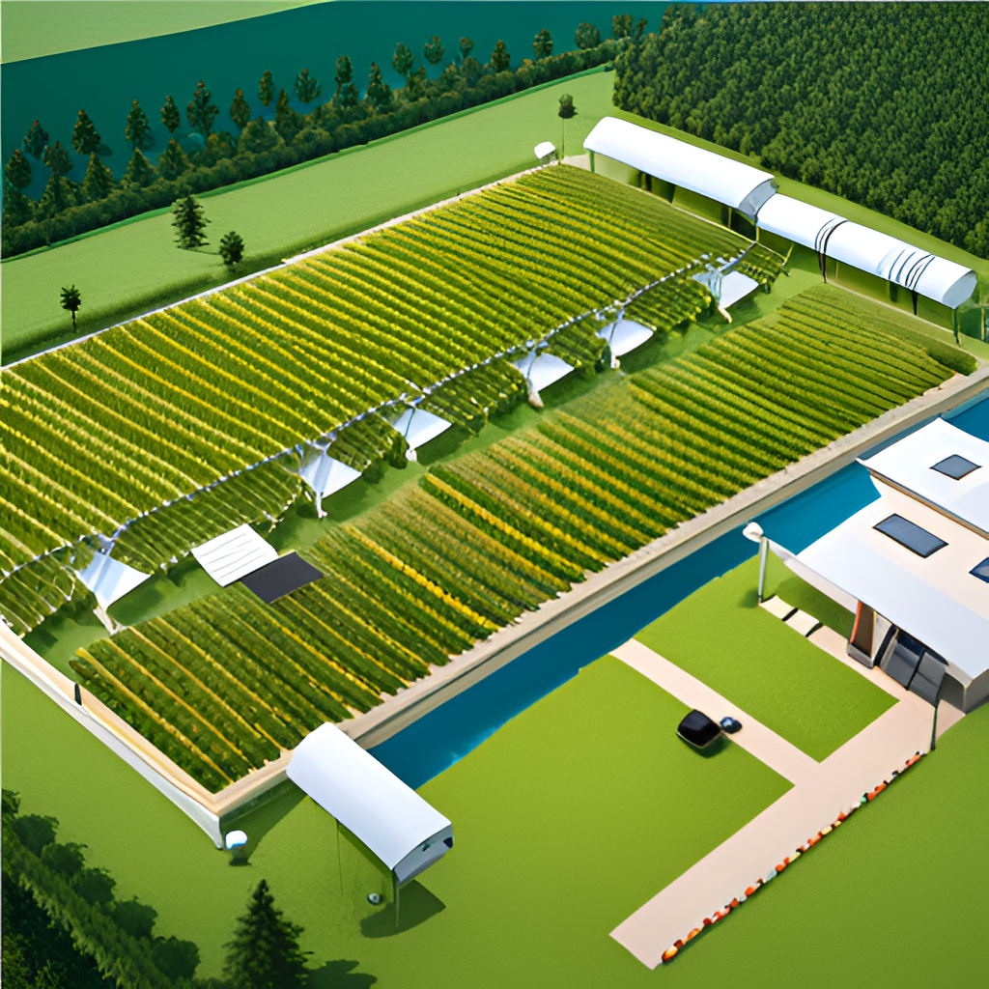
PROPOSED SYSTEM DESIGN
Our system employs high-resolution cameras and machine learning algorithms for detecting apple leaf diseases in orchards, with cameras strategically positioned to capture leaf images.
Machine learning algorithms, trained on a diverse dataset of healthy and diseased leaves, process the images and provide real-time monitoring and alerts, enabling prompt action by farmers upon disease detection.

Slide 13

DATASET
Our apple leaf disease detection system will deliver high accuracy through machine learning and image processing.
This advancement is poised to significantly reduce economic losses from apple leaf disease, underscoring the need for continued research to enhance system efficiency.

Slide 14
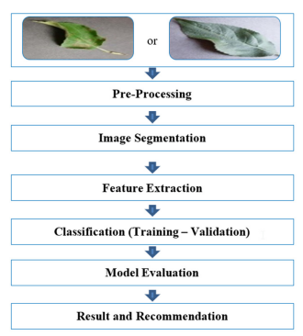
PROGRESS CHART
Completed initial research phase, including literature review and research gap identification.
Currently in the data collection and system implementation phase, with upcoming milestones in testing, analysis, and result presentation.

Slide 15
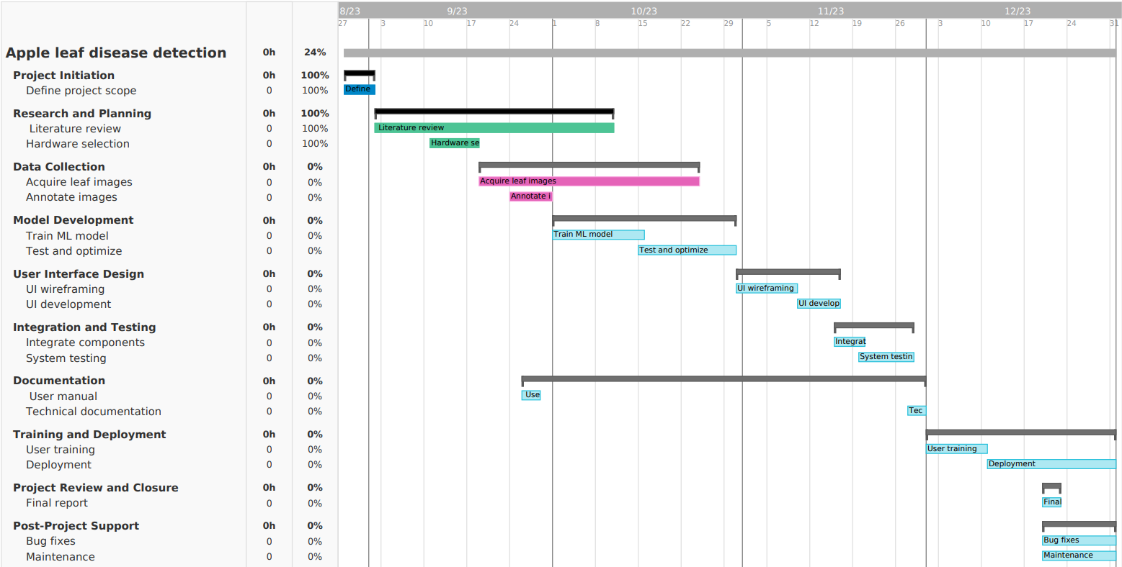

Slide 16

CONCLUSION
Future advancements in apple leaf disease detection systems are expected to offer high accuracy through the integration of machine learning algorithms and image processing techniques. This innovation holds the potential to minimize economic losses from the disease, emphasizing the need for ongoing research to enhance system precision and effectiveness.

Slide 17

REFERENCES
1. Smith, J., & Johnson, K. (2018). Apple leaf disease detection using machine learning algorithms. Journal of Agricultural Technology, 14(2), 45-56.
2. Lee, S., Kim, H., & Park, C. (2019). Deep learning-based apple leaf disease detection system using convolutional neural networks. Computers and Electronics in Agriculture, 157, 342-350.

Slide 18
THANK YOU
ANY QUESTIONS?

